Slide 1



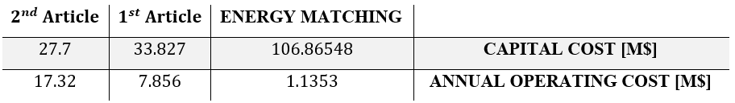
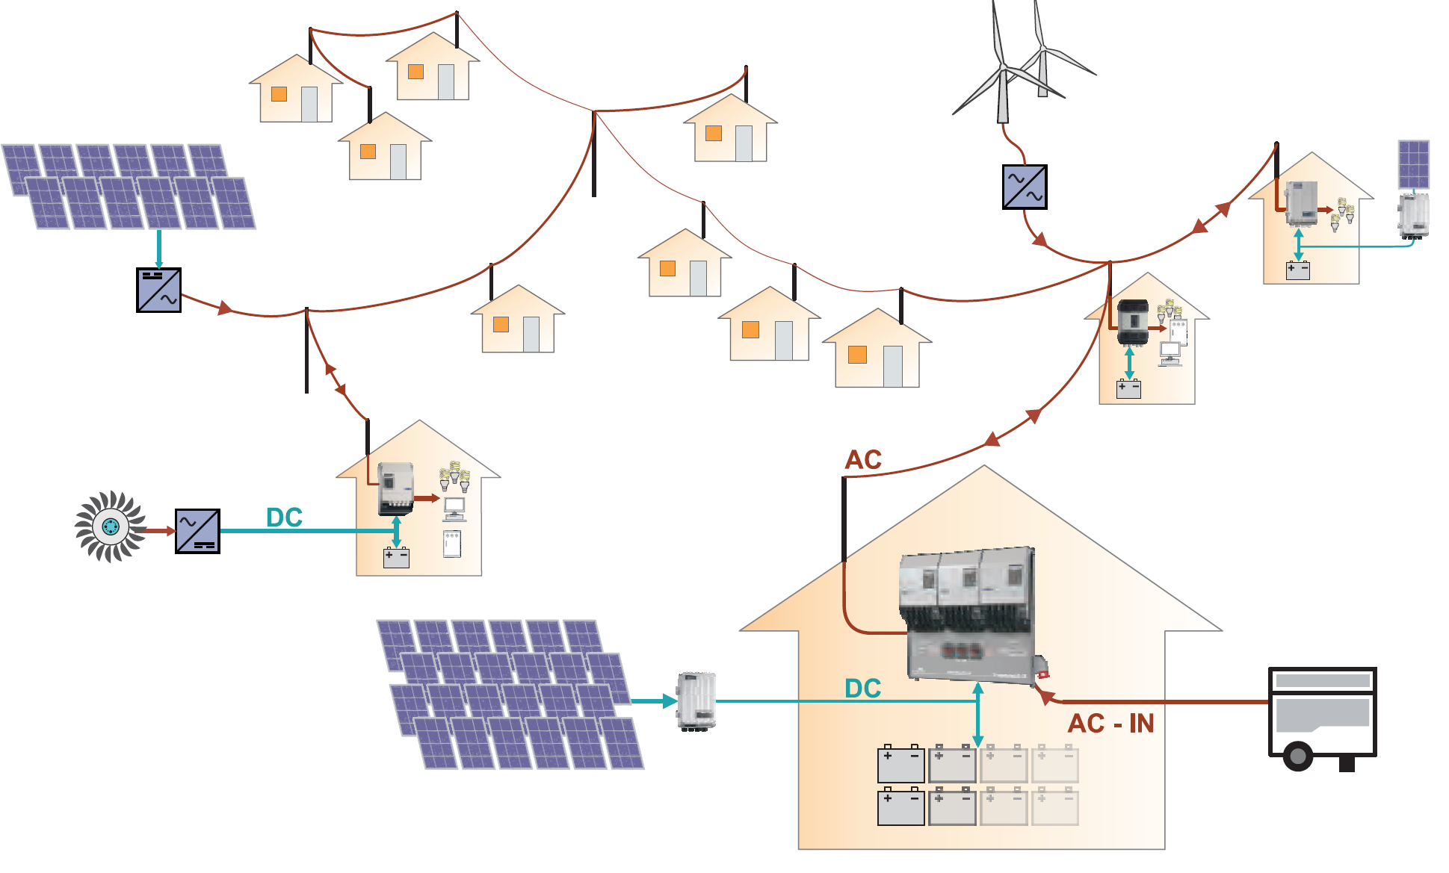
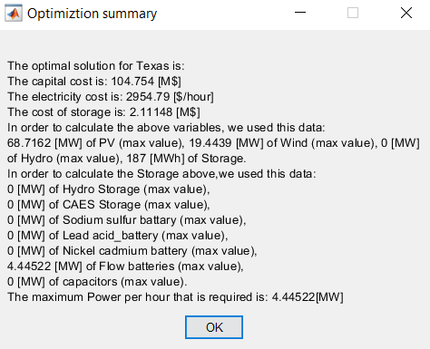
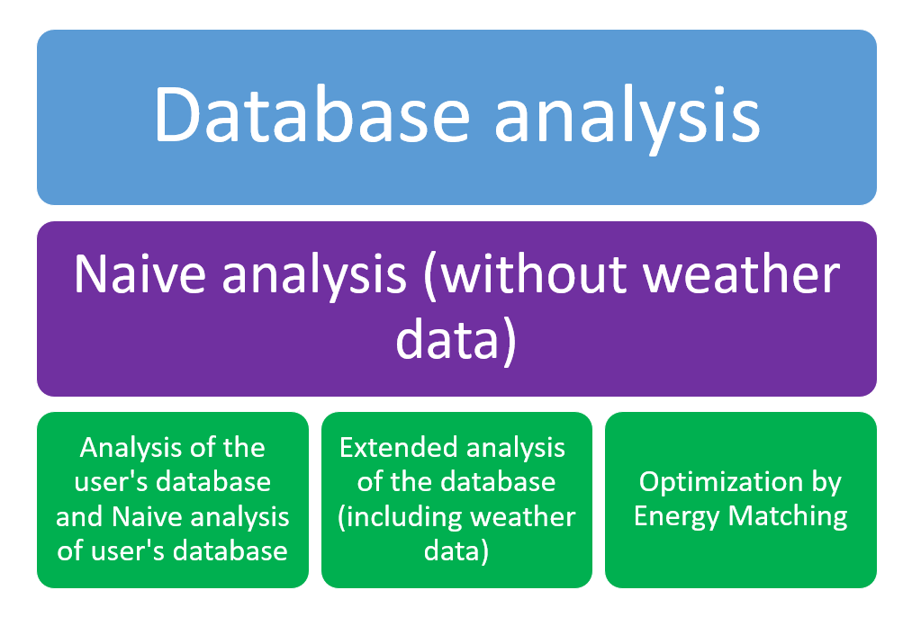
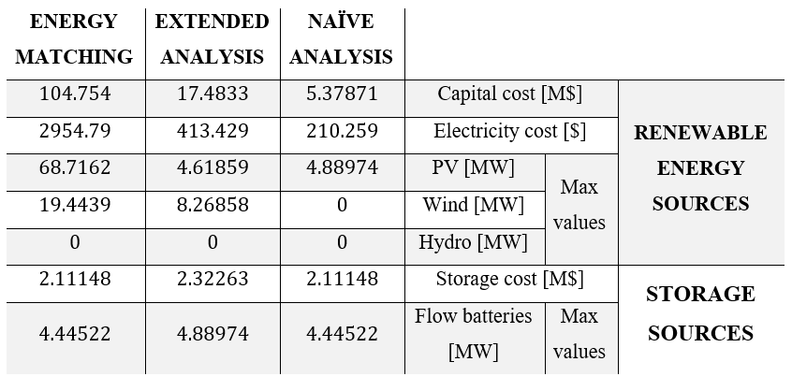

Continuous Energy for a Crucial Facility
Which is lacking of Resources
Elad Itzhak and Guy Dauber, Supervised by Michael Perl
Introduction
Energy Matching
Systems Comparison
Renewable energy systems are a crucial step against climate change and global warming
Renewable energy sources are getting cheaper and are more available
Renewable energy systems allow fully autonomous and local control of the power supply, using mini-grids
Renewable energy mini-grids allow economic efficiency under variety of constraints
Energy Matching costs Vs. other articles costs
We got better annual operating cost, but worse capital cost
Economic Benefit
Energy Matching Use by source
Most of the use of renewable energy is with the help of solar energy
The use of storage sources is lower in the summer months as we might expect.
Renewable energy mini-grid example
Energy Matching costs Vs. other articles costs
Goals
With different inflation rates our optimization is almost always below the articles
For 𝛼 = 0.9 this does not hold within the 30-year time frame
It can be concluded that optimization by operating costs is more beneficial optimization.
Minimize the total cost required for a complete renewable energy mini-grid
Consists of 100% renewable energy, including generation and storage
Continuous operation under various weather and power demand conditions
Edge Cases
Energy Matching – State of Charge
There is less use of storage sources in the summer.
The critical days are in the winter days.
Challenges
Conclusions
Severe weather conditions
Area needed for power plants (solar panels and wind turbines)
Electrical characteristic and integration treatment
Economic dispatch model for the generation and storage sources
Energy matching method leads to more realistic costs
With sufficient duration of time ($\sim 30 years$), our solution is more beneficial for down to inflation value of 0.925
Our optimization reached significantly cheaper operating cost, but the capital cost was more expensive
It is more beneficial to optimize over operating cost, rather than capital cost
It might be helpful to partially use our analysis, and add more green energy source if possible
Energy Matching Summary
Data Analysis
Energy charging occurs when possible.
The peaks for wind energy and solar energy are significantly higher and therefore the costs are higher.
Comparison between optimizations
Further Possible Projects
Further analysis, using nuclear energy facilities
Categorizing generating and storage sources, with different weight in the analysis
More comprehensive modeling and accurate analysis:
Taking electrical characteristics under consideration
Real time analysis and response, using short-term weather forecast, dynamic control and adaptive signal processing
The data analysis was implemented using MATLAB, with user friendly interface
Naïve approach was used at first, without consideration the whole available data
The analysis includes a simple model for the storage sources’ state of charge
Optimizations Compairson
Energy Matching: Capital and operating costs are very high but more realistic.
The Naïve analysis gives a very far assessment from our final assessment
April 2022

